Slide 1
A hands-on workshop for the experimental design analysis and interpretation of RNA-seq data for interdisciplinary research
SACNAS NDiSTEM Conference 2023
Portland, OR

Slide 2
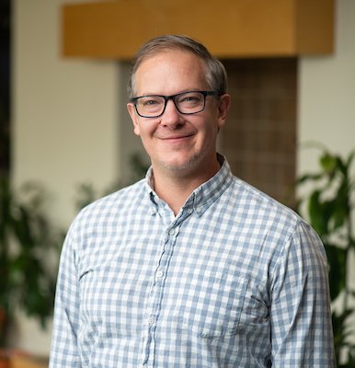

Seth Frietze, PhD
Ph.D.; Harvard University
Postdoctoral training; University of Southern California Medical School Norris Cancer Center
Associate Professor
Program co-leader UVM Cancer Center Cancer Cell Program

Slide 3

Princess Rodriguez, PhD
MS in Immunology
PhD, Cell and Molecular Biology
Started my bioinformatic journey in 2015 as a grad student in Seth’s lab.
Assistant Professor
Teach intro and advanced bioinformatics at UVM

Slide 4
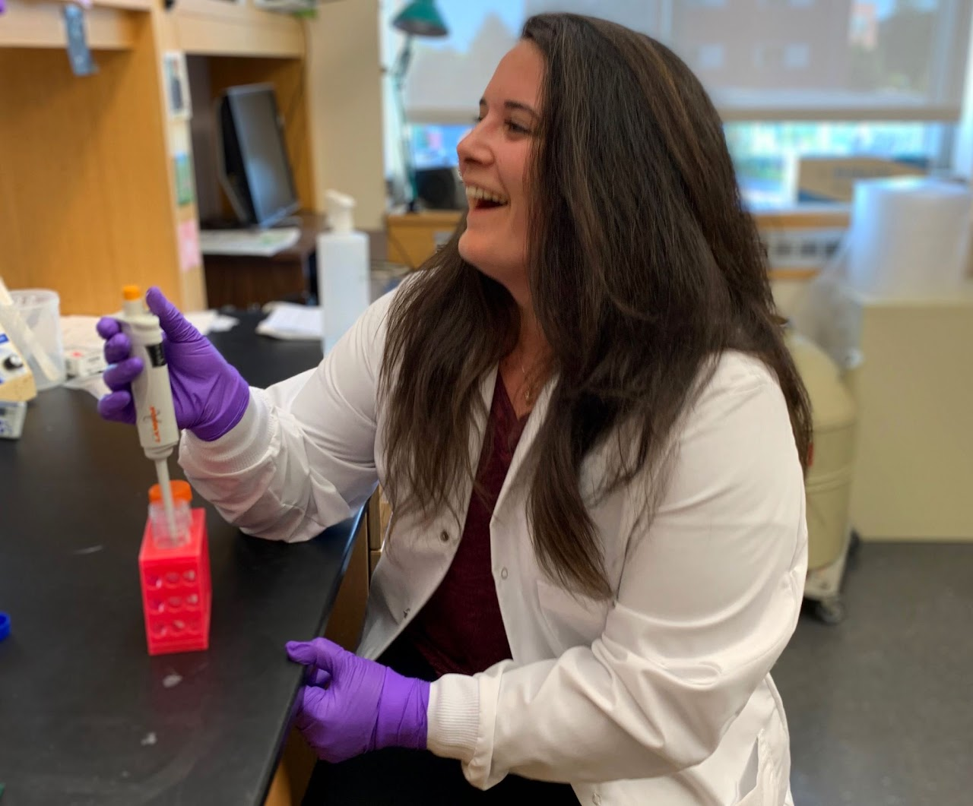

Noelle Gillis, PhD
BS in Microbiology & Molecular Genetics
PhD, Cell and Molecular Biology
Started my bioinformatic journey in 2016 as a grad student in the co-mentored by Seth Frietze.
Currently a postdoc at U Minnesota Masonic Cancer Center.
Working on projects related to steroid receptor transcriptional regulation in breast and ovarian cancer models.

Slide 5


Sophie Kogut
BS in Biological Science
Former research tech in Seth’s lab
PhD student in the Molecular and Cellular Biology Program at the University of Washington / Fred Hutchinson Cancer Center

Slide 6
Module 1:
Overview of RNA-seq

Slide 7

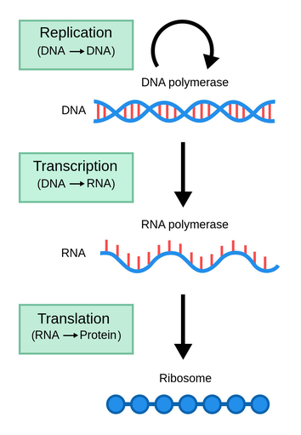
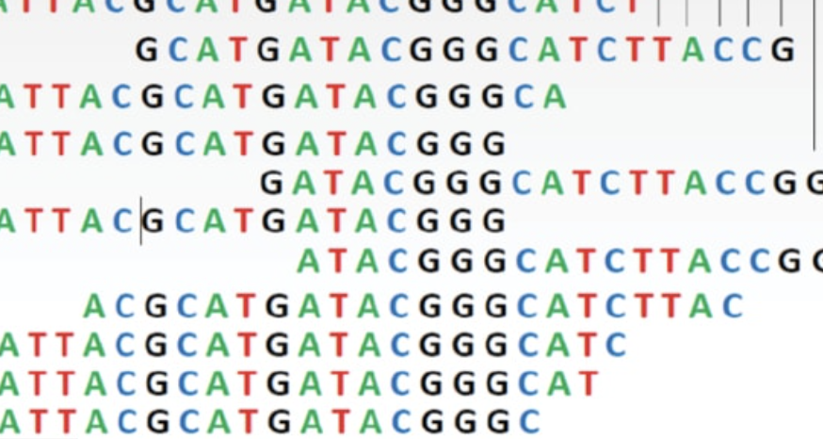
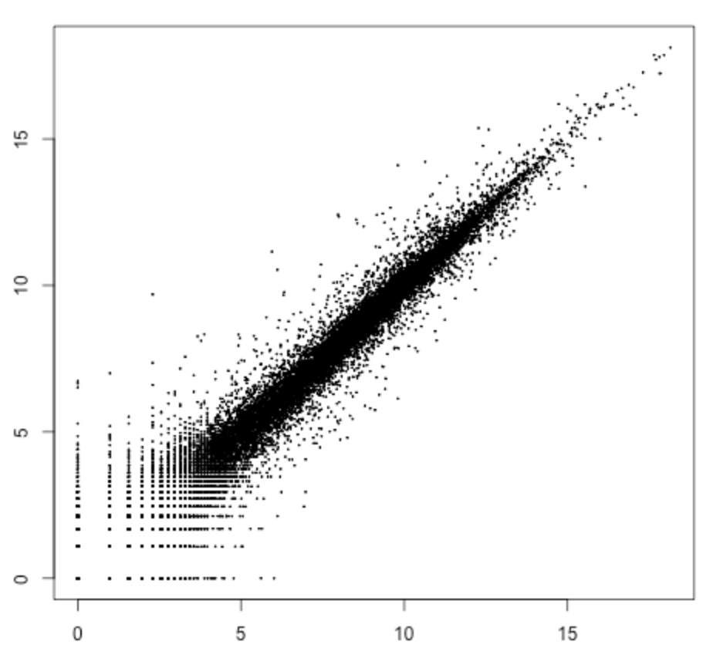
RNA-seq overview
Experimental
design
Biological material
Total RNA
Experimental (“WET”)
cDNA libraries
Library prep
Sequence
Analysis (“DRY”)
Analyze

Slide 8
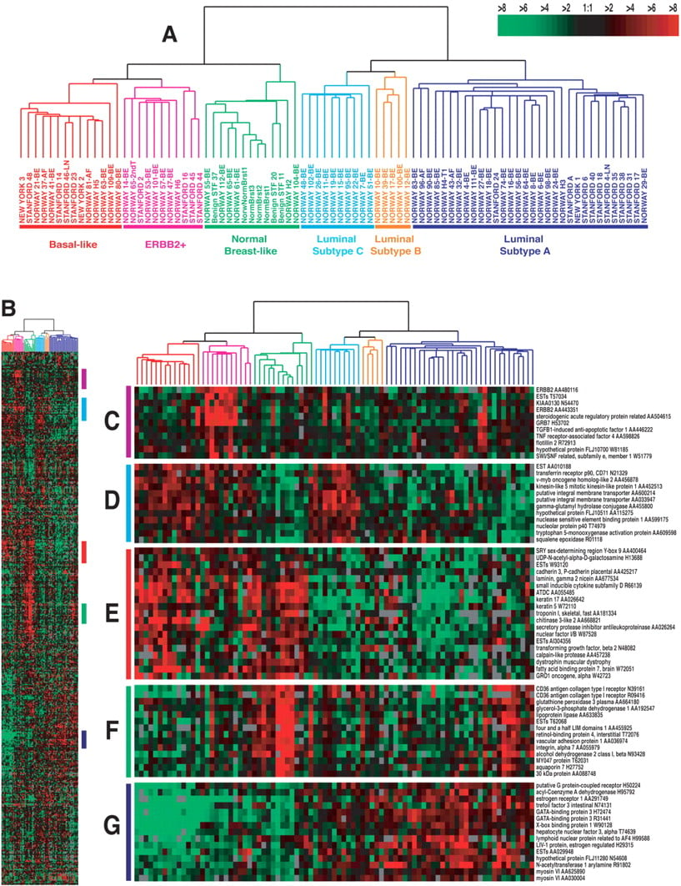
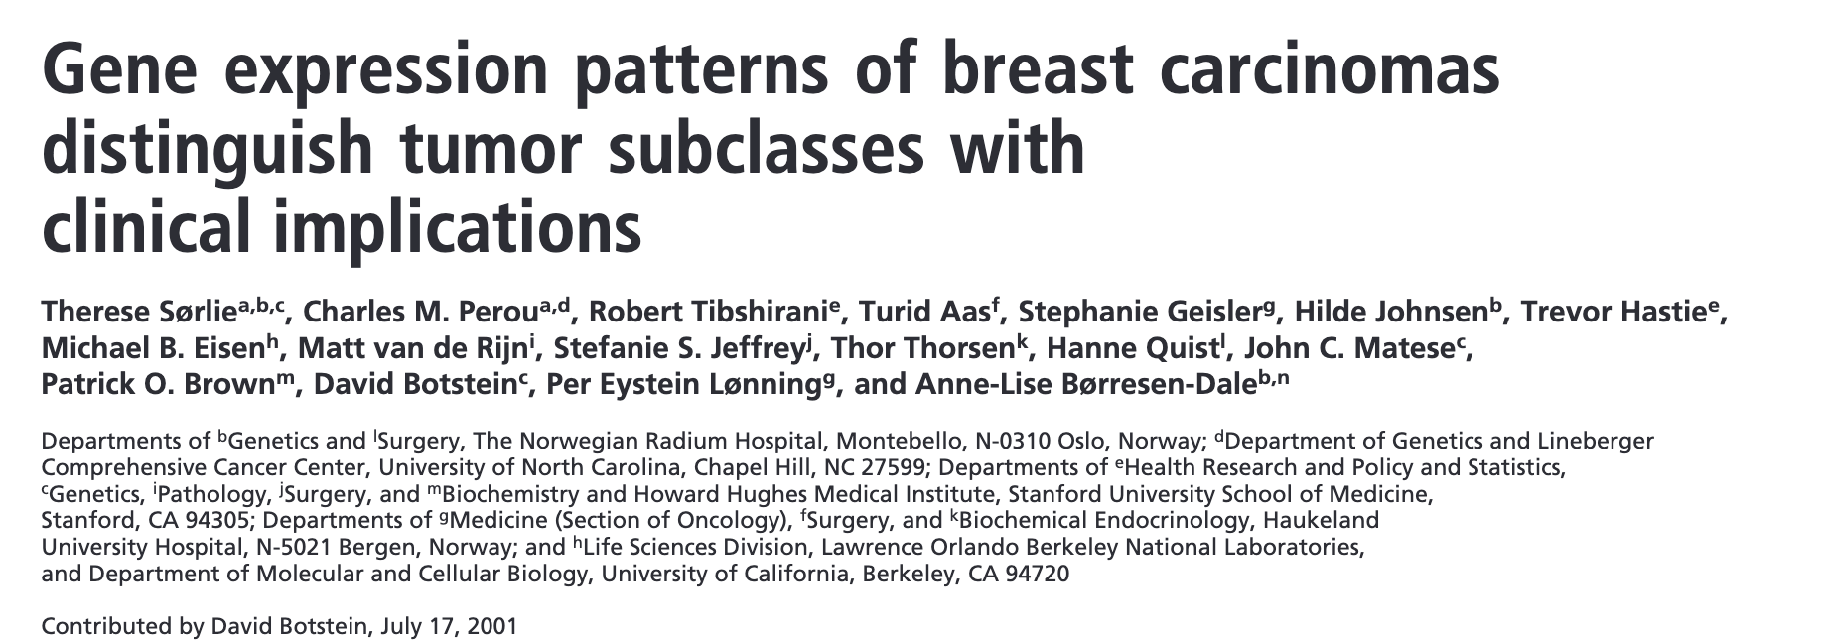
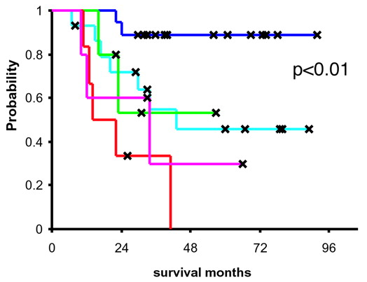
Breast cancer heterogeneity
Molecular subtypes of breast cancer
Gene expression is diagnostic and prognostic

Slide 9
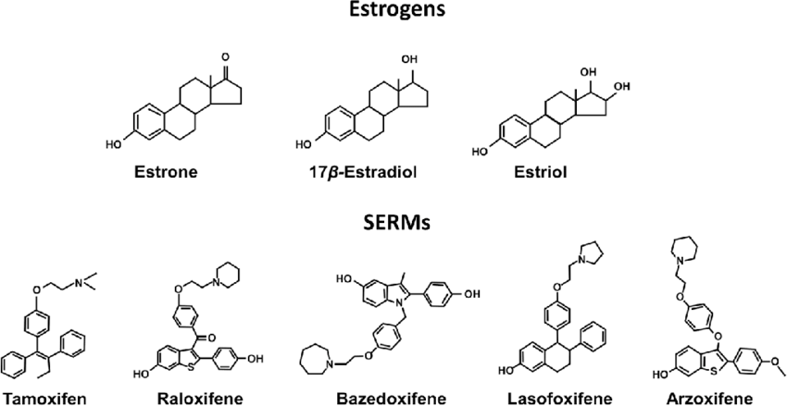
Endocrine therapies are based on estrogen ligands

Slide 10
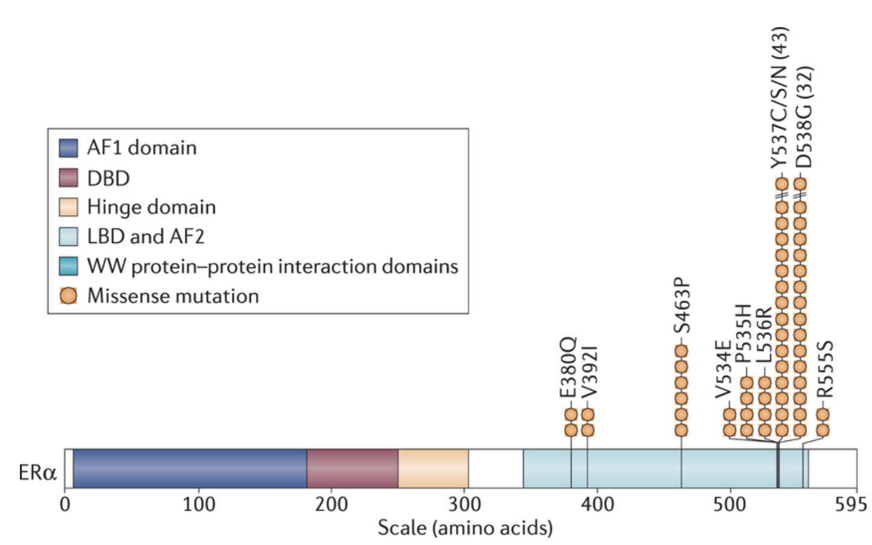
ESR1 mutations are common in endocrine therapy resistance (ETR)
Endocrine therapies
Estrogen (E2)
ER
+
ER
X
Resistance
X
Tumor
Growth
Nucleus
ER
MYC

Slide 11
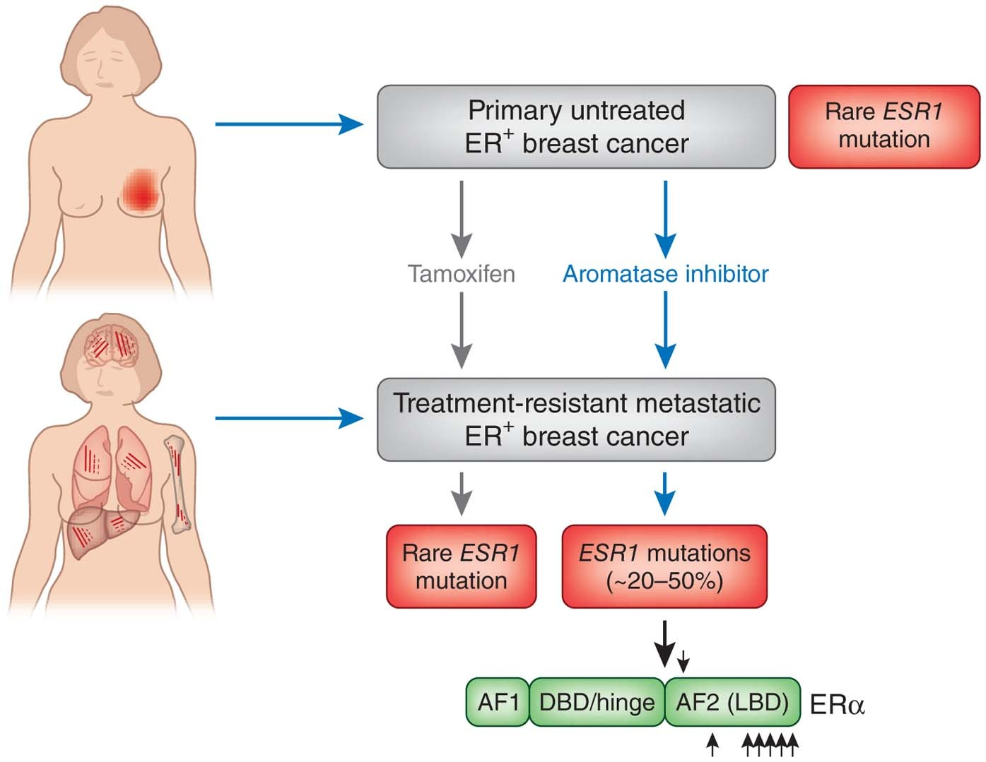
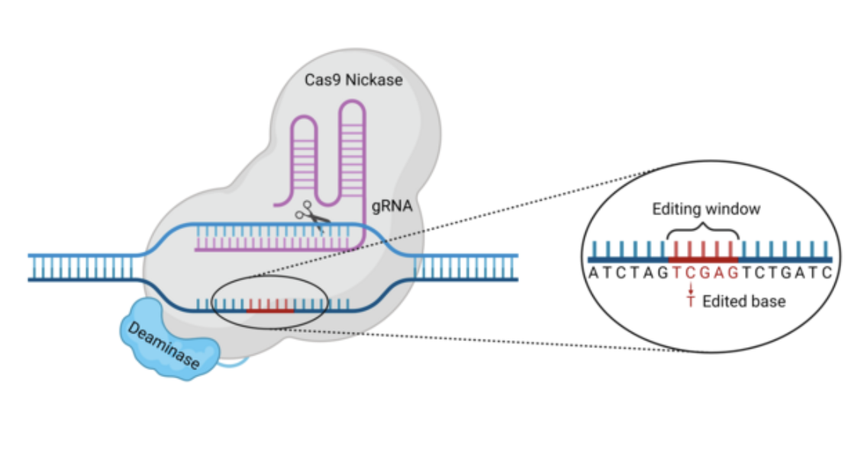
Cell models to study ETR: CRISPR engineering ESR1 Y573S
MCF-7 (ER+)
MCF-7 (ER+)
parental
CRISPR base-edit
Y537S
CRISPR-base editing method
Find ESR1 sequence on Genome browser
Protein sequence on Uniprot
Import sequence into benchling, design gRNAs
Generate vectors, deliver and select stable cell lines
Characterize (RNA-seq)

Slide 12
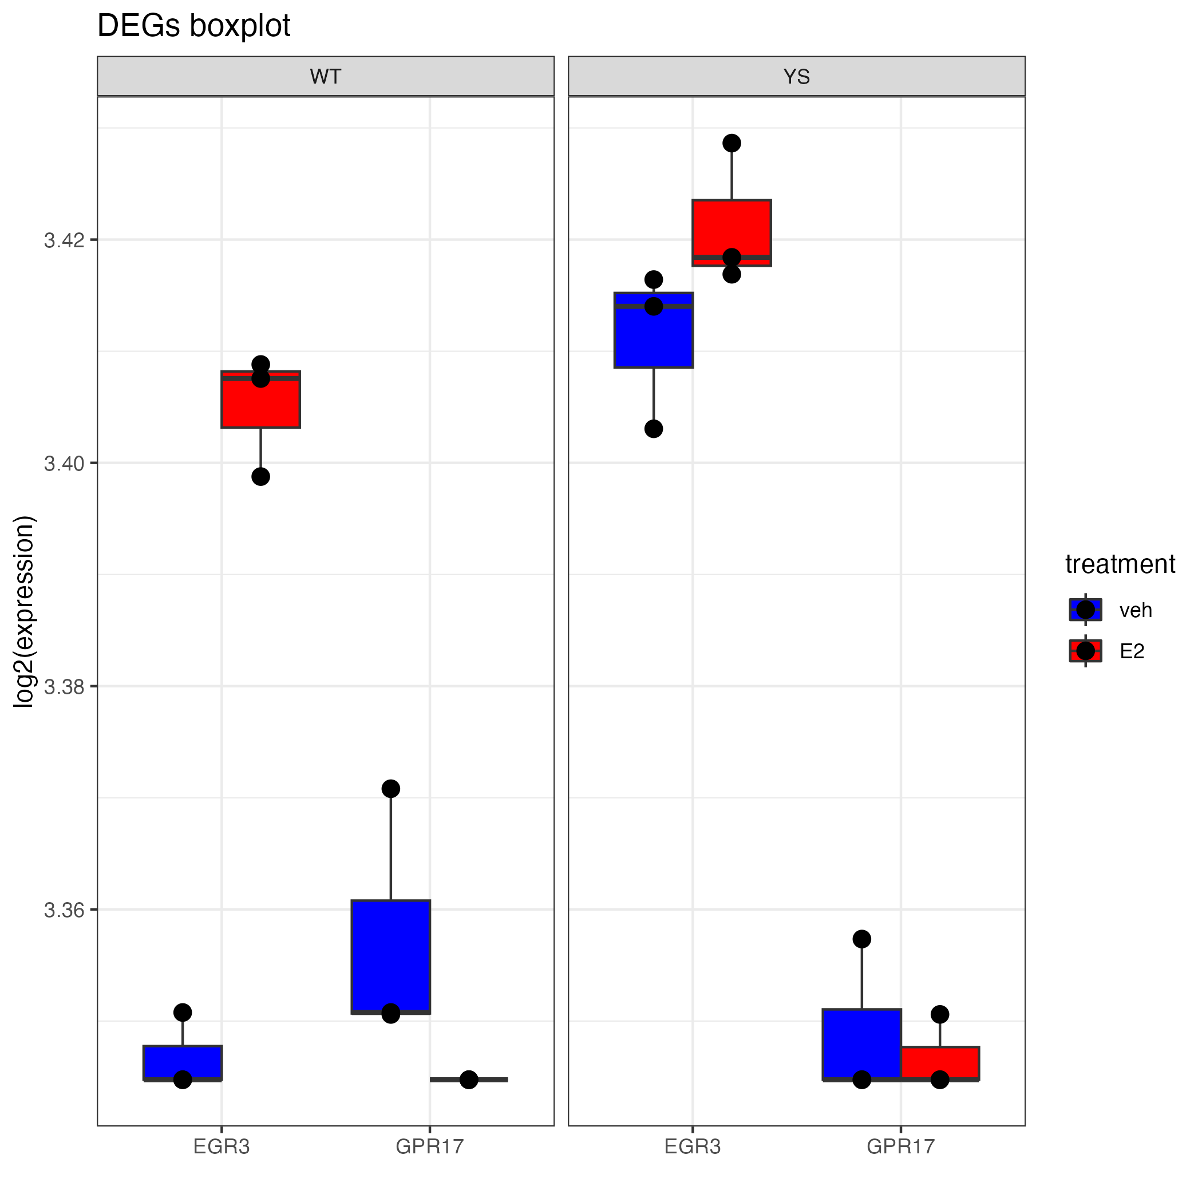
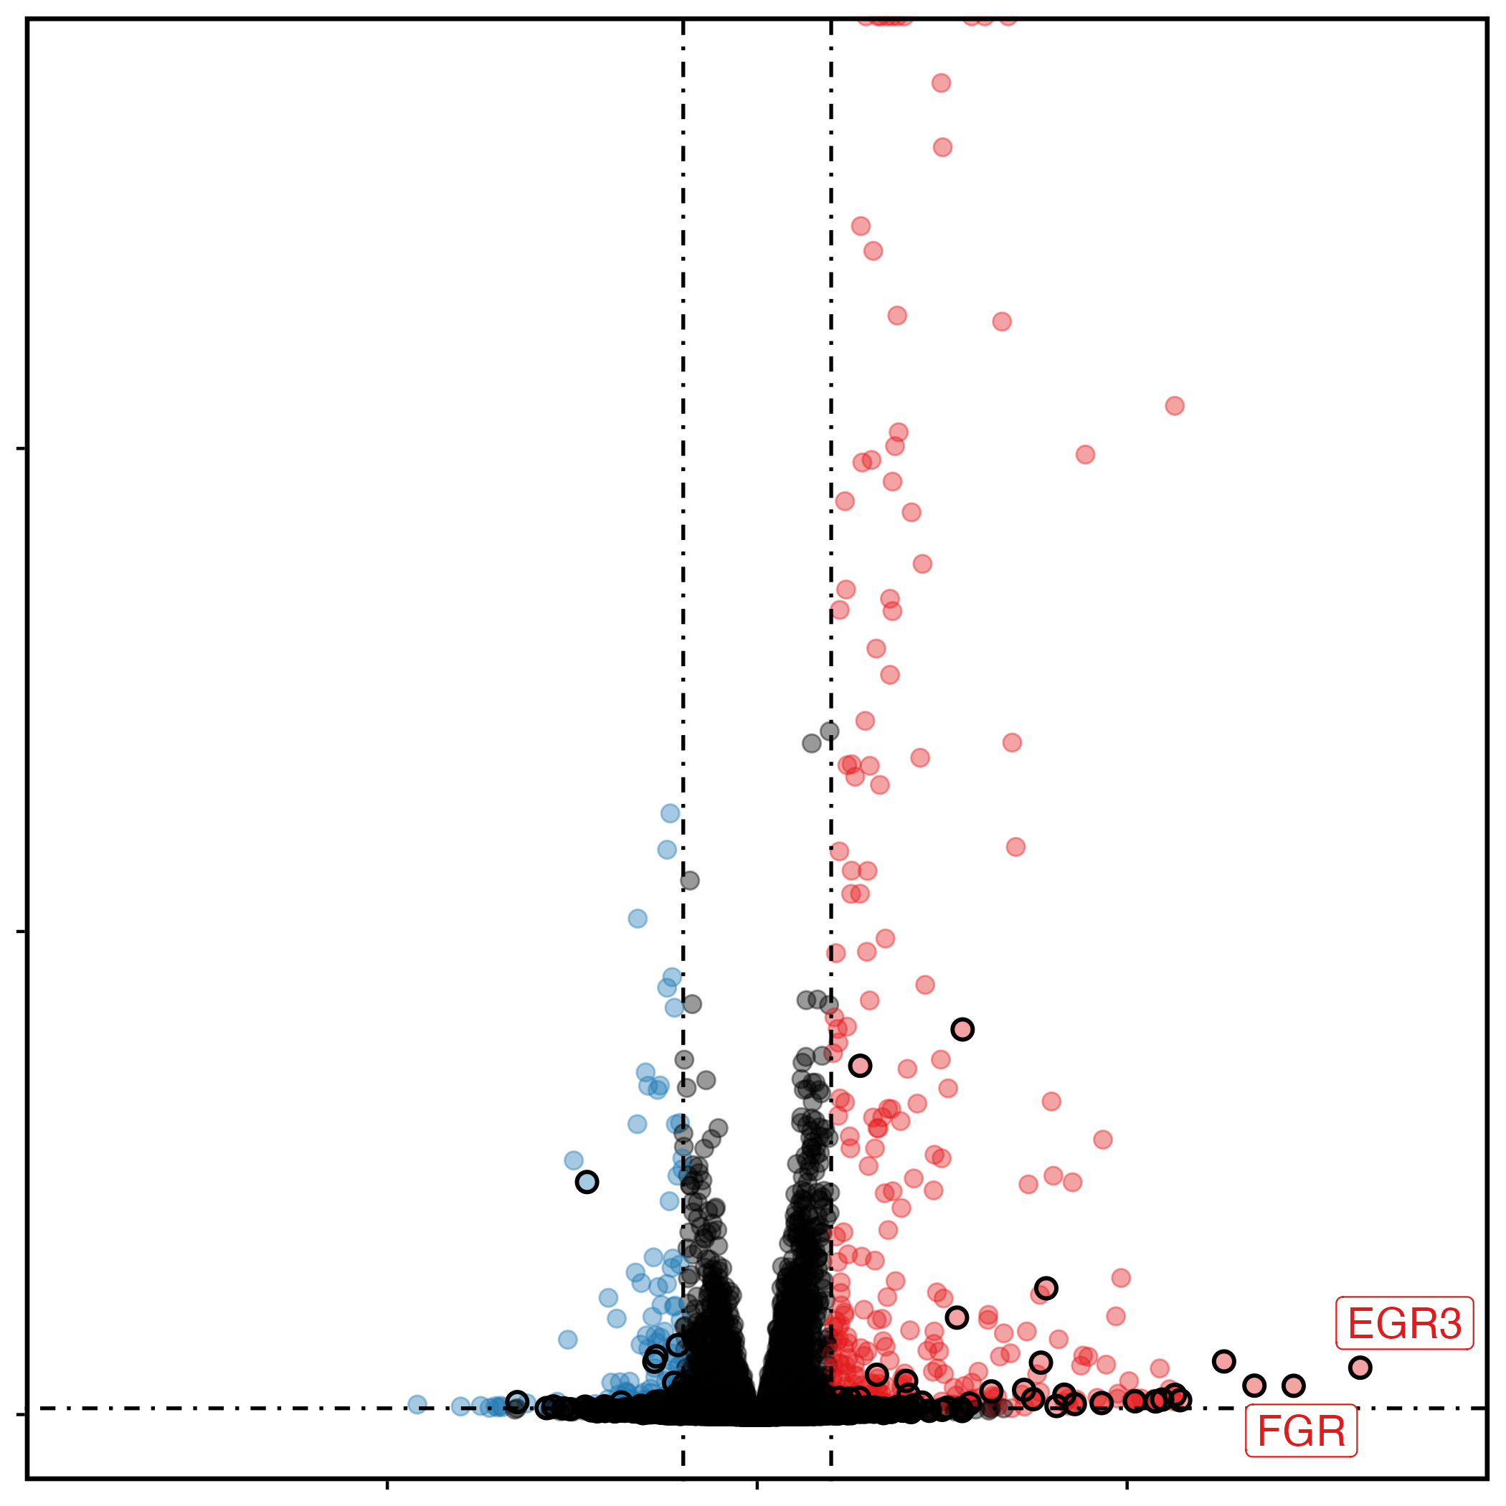
genotype
treatment
ER
Δ
DMSO/E2
6hr
RNA-seq analysis
ER
Parental (wild-type)
ER target gene
Wild-type
Y573S
Y573S
Log10(-padj)
Fold-change
(E2 versus DMSO)

Slide 13
Module 2:
Post-Sequencing Processing Steps

Slide 14
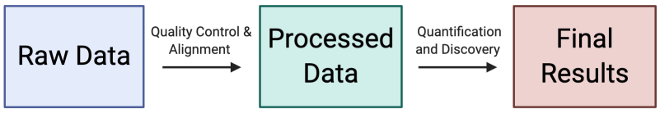

Steps to get you from raw RNA-seq data to DEG’s and beyond!
How I learned how to do this:
Trial and Error.
Spending lots of time reading the program manuals.
Googling error messages.
Asking for help when I get stuck.

Slide 15
Steps to get you from raw RNA-seq data to DEG’s and beyond!
Phase 1: Processing
Processing Step | Tools
Quality control of raw sequences | FastQC, cutadapt, trimGalore
Alignment/Mapping to the genome | STAR
Generating gene counts | HT-seq, Salmon
Phase 2: Analysis
Analysis Step | Tools
Quality control of replicates | DESeq2, edgeR
Differential expression analysis | DESeq2, edgeR
Pathway analysis | GSEA, IPA, clusterProfiler

Slide 16
Quality Control of Raw Sequences
FASTQ File Format
Quality Control Steps
Generate FASTQC reports.
Check the quality of base-calls.
Check for “over-represented sequences.”
Trim low-quality bases.
Remove adapter sequences.
Example Commands:
fastqc 2D_WT_shGFP_E2_R50_001_S10_R1_001.fastq.gz
trim_galore --paired --Illumina 2D_WT_shGFP_E2_R50_001_S10_R2_001.fastq.gz
2D_WT_shGFP_E2_R50_001_S10_R2_001.fastq.gz

Slide 17
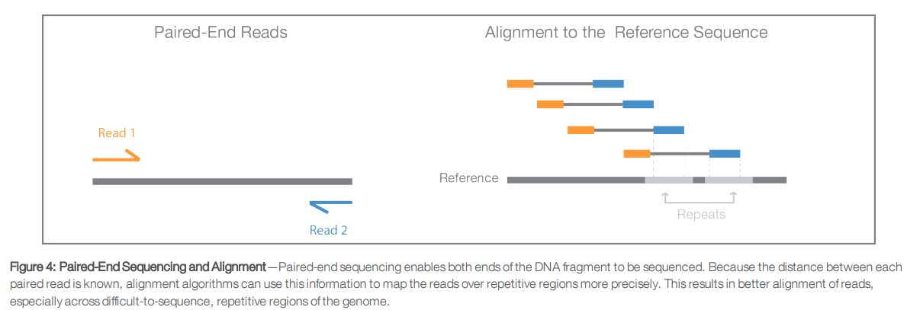
Alignment/Mapping to the Genome
Alignment Steps
Align FASTQ files to a reference genome.
Check the alignment statistics.
Adjust alignment settings as needed.
Convert to BAM format.
Where do you get the reference genome files? https://www.ncbi.nlm.nih.gov/assembly/GCF_000001405.26/
Example Command:
STAR Alignment Summary:
STAR --runThreadN 12 \
--genomeDir /home/langeca/gilli431/software/STAR_hg38 \
--readFilesCommand zcat \
--readFilesIn 2D_WT_shGFP_E2_R50_001_S10_R1_001.fastq.gz 2D_WT_shGFP_E2_R50_001_S10_R2_001.fastq.gz \
--outFileNamePrefix 2D_WT_shGFP_E2_R50_001
Number of input reads | 35202511
Average input read length | 299
UNIQUE READS:
Uniquely mapped reads number | 33777023
Uniquely mapped reads % | 95.95%
Average mapped length | 298.68

Slide 18
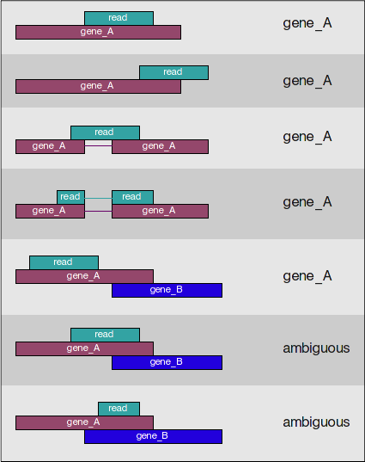
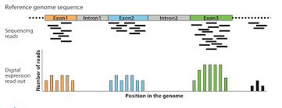
Generating Gene Counts
Gene Counting Steps
Check that bam files are sorted and indexed
Run HT-seq on bam files.
Save .cnts files for analysis.
Example Command:
htseq-count -f bam -r name -s reverse -m union -i gene_id bam_files/${base}_sorted.bam ~/software/gencode.v38.primary_assembly.annotation.gtf > count_files/${base}.counts

Slide 19
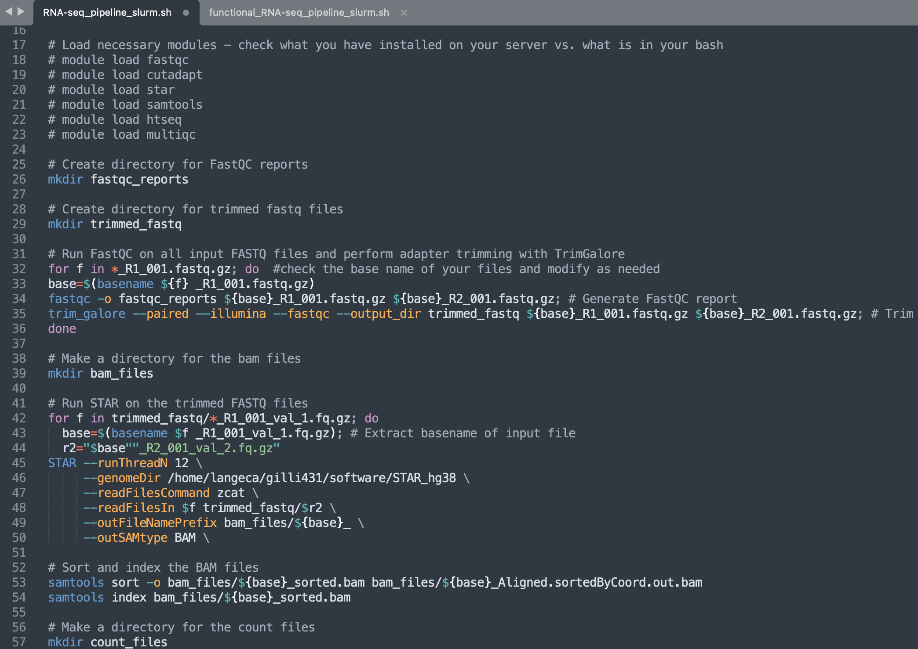
All these steps can be strung together into a “pipeline.”
Alignment
Read counting
FASTQ
Bam
Counts
Put the raw data for the experiment you are analyzing into a single folder (on MSI).
Modify the SLURM header in the pipeline script
Send the job out for analysis.
Wait 12-24 hours.
Check your QC metrics and retrieve the count files.

Slide 20
What can be done with the processed data?

Slide 21
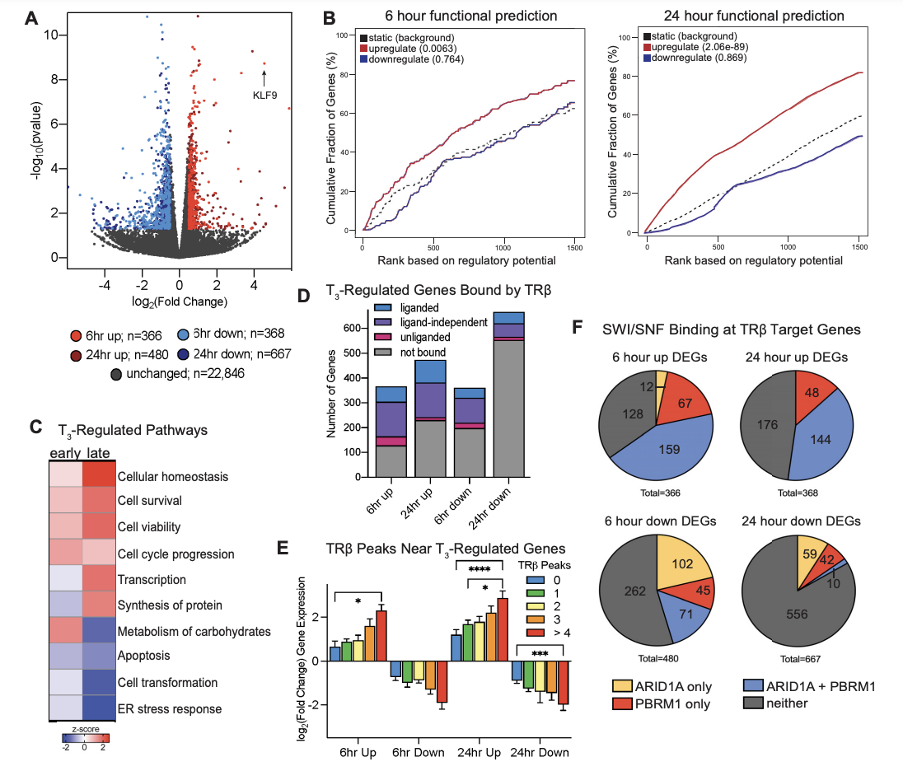
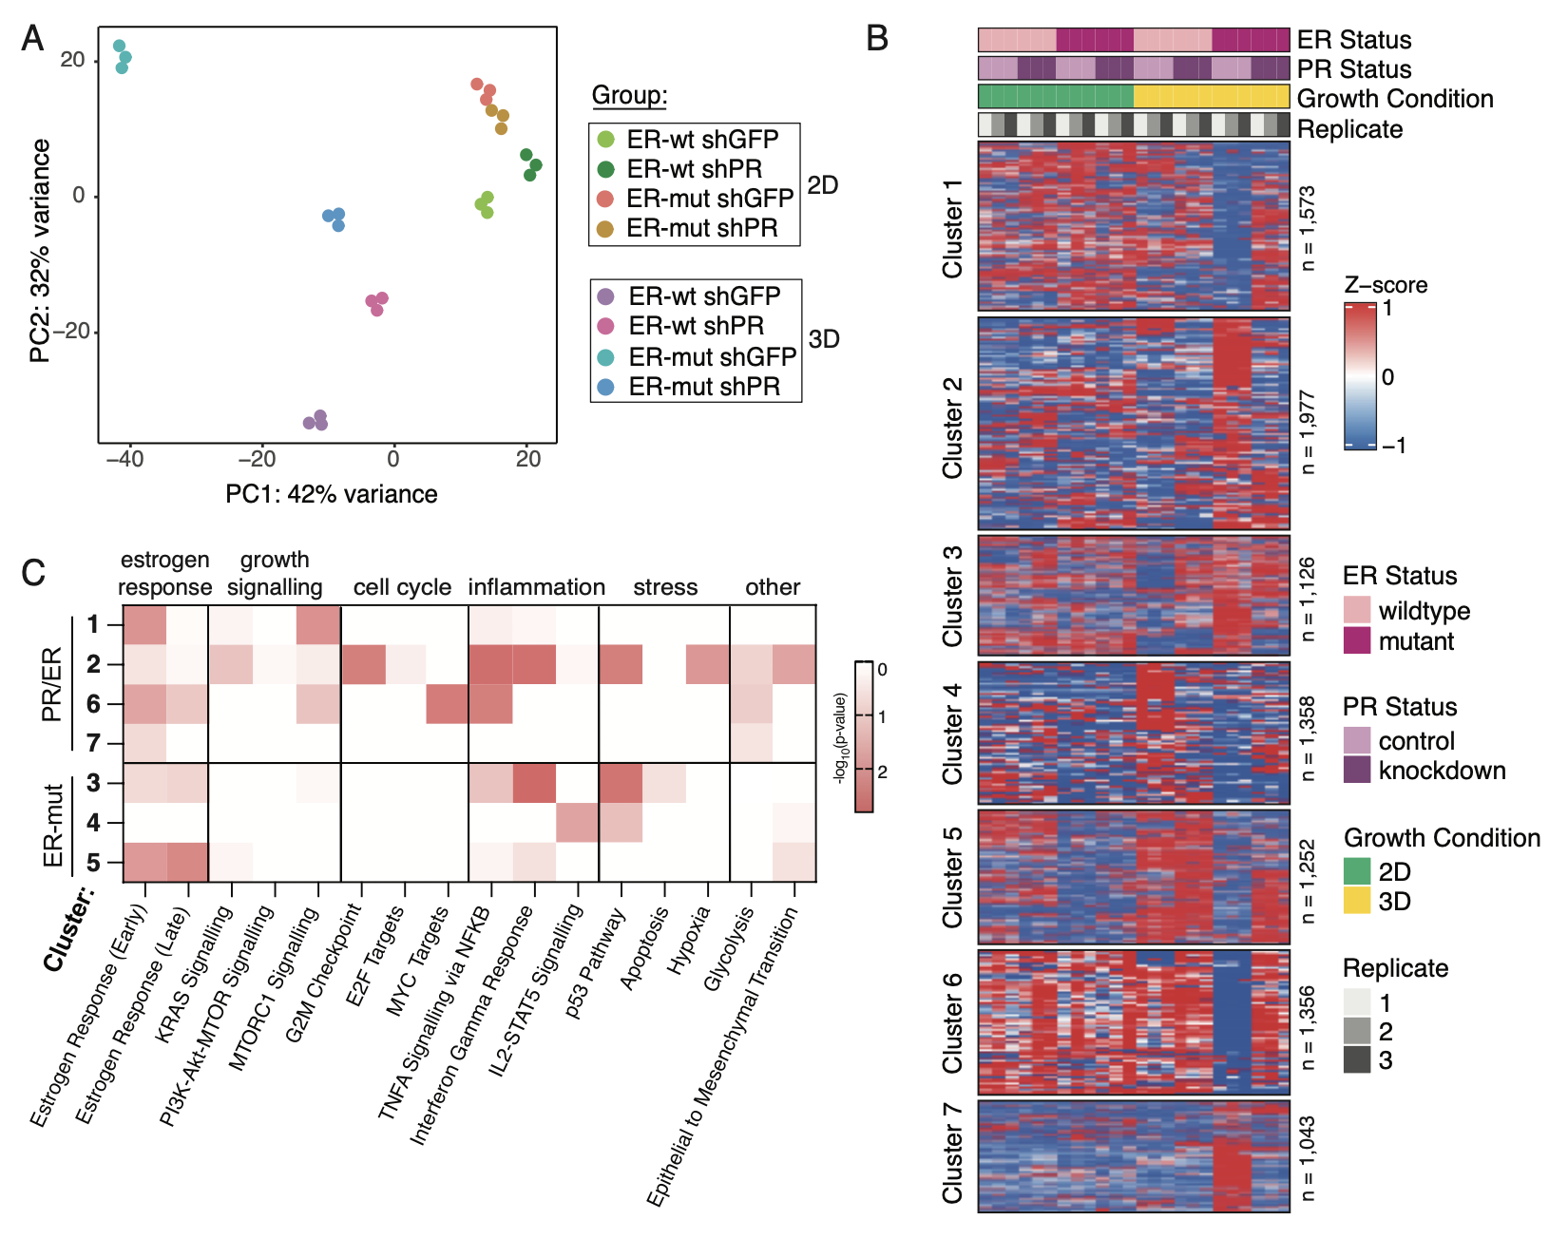
What can be done with the processed data?

Slide 22
Module 3: Hands-On Workshop
Group A
Group B
Group C
Is this your first time analyzing an RNA-Seq dataset?
Do you have previous experience with R/Rstudio?
Do you have questions about an RNA-Seq dataset you generated or would like to analyze?
Participants without a laptop or are new to RNA-Seq are encouraged to join Group A
Participants with a laptop are encouraged to join Group B
Informal discussion about NGS

Slide 23
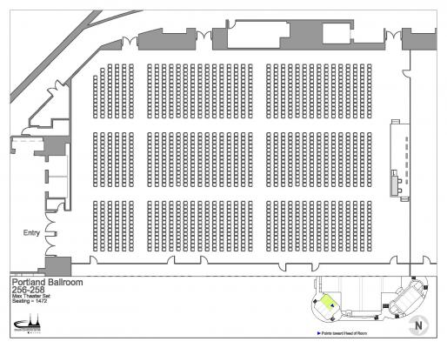
Hands-On Workshop
Group C
Group A
Entrance
Podium
Group B
Please take a few minutes to join a group!

